Slide 1
From Story to STM by Way of Requirements… a benevolent introduction
Betsy Pugel
NASA Goddard Space Flight Center

Slide 2
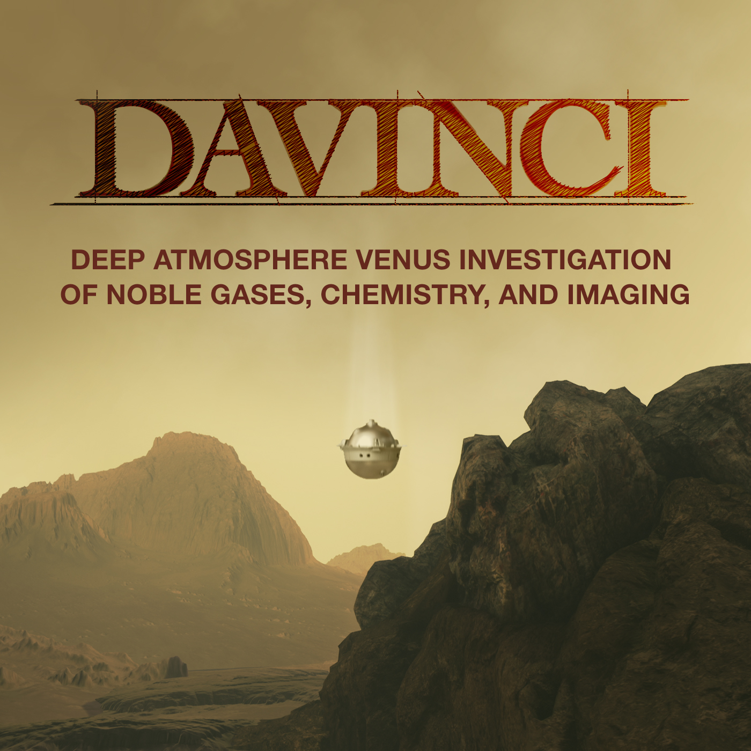
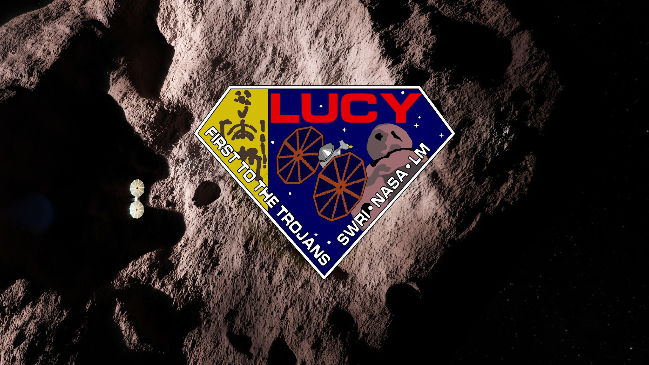
About me
I tried to fit in a box and well, that just never worked for me and people around me seem to appreciate that.
(space is multidimensional after all…)
Recent mission proposals that I have known and loved
(and helped to win!)

Slide 3

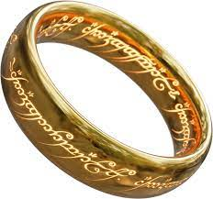
Goals
Objectives
Requirements
STM

Slide 4
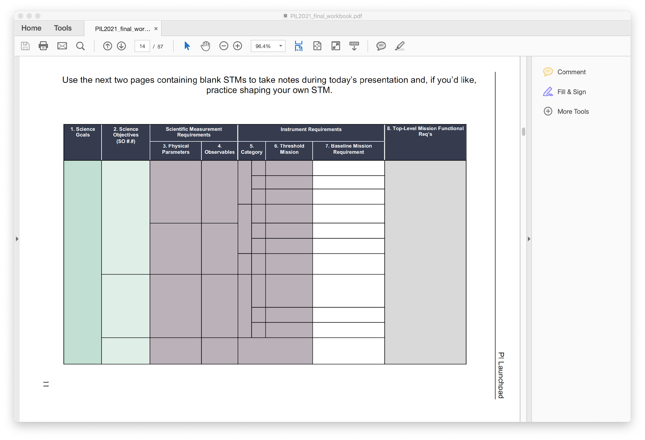

STM
Requirements
Notes:
Instrument Performance Requirements.: what is needed to make a measurement? Two categories—baseline and threshold…
Baseline:full scie
Threshold: minimum science
You’ll hear this from me again on Thursday when we come back to all of this and talk about requirements, so don’t worry, but this is a fun digression so….

Slide 5
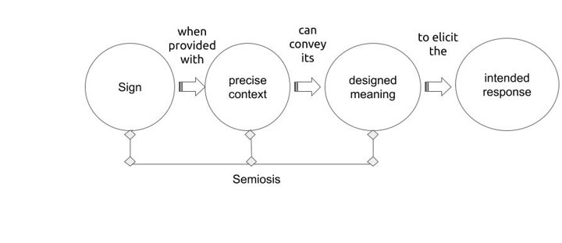
Requirements + Semiotics + STM
P.Berger and T. Luckmann, The Social Construction of Reality

Slide 6

Nathan Pyle, Strange Planet

Slide 7
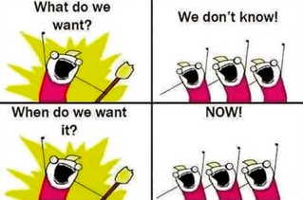
What are requirements?
Hint: You use them all the time….
But…you DO know!
Notes:
One of the more amazing experiences in my life as a freshman here in the honors college was when one of the regular counselors told me that I was interested in so many things that I should become a barista. Thank goodness I ignored that person’s advice, though in homage to that key moment in my life, I now use it as a teaching moment here…

Slide 8

What are requirements?
Or, how not to listen to a freshman year counselor…
“I’d like a hot medium decaf mocha.”
Requirements Translator:
The shop shall provide a decaf mocha.
The decaf mocha shall be 12 ounces, combined
with a single shot of decaffeinated espresso and some chocolate.
Barista: What kind of milk? Oat? Almond? Soy? Skim? 1% ? 2%? Whole?
Me: Whole, please.
Two minutes later, a 12 oz decaf mocha with whole milk appears
What was not specified in this requirement:
        What kind of cup---providing your own? Using theirs?
        What kind of lid?
        What temperature? What is meant by “hot”?
        Here/takeaway?
        How much chocolate?
        How much foam?
        Foam bubble size?
Assumptions:
The drink shall be delivered to me in less than 5 minutes (unless it’s a pourover-based drink, a big line, etc.)
A ”reasonable” amount of chocolate will be included
That a decaf request = decaf received. What does it mean anyway?
No other shop is providing the mocha.
Notes:
One of the more amazing experiences in my life as a freshman here in the honors college was when one of the regular counselors told me that I was interested in so many things that I should become a barista. Thank goodness I ignored that person’s advice, though in homage to that key moment in my life, I now use it as a teaching moment here…

Slide 9
Welcome to the world of requirements!
You’ll start to realize…how many deliverables you accept on a daily basis where you’ve not fully specified details and how it turns out ok…most of the time.
DISCLAIMER: This presentation is not meant to forever ruin your enjoyment of the simple things in life and all the things we know and trust on a daily basis.
(You may gasp at how much we assume and trust, though!)

Slide 10
Basic Elements of a Requirement
Contains a
“shall” in it..
Conveys expectations for what is to be delivered
A way to clearly communicate
Contains one thought per statement
Single interpretation
Active Voice:
“Who” shall “what”?
Plain English
No “and/ors”
Stated Positively
"shall" vs. "shall not"
The drink shall be 12 ounces, combined
with a single shot of decaffeinated espresso and some chocolate and
no whipped cream.
…Uh oh, let’s try this again….

Slide 11
Basic Elements of a Requirement
The drink shall be 12 ounces, combined
with a single shot of decaffeinated espresso, whole milk and some chocolate.
This time, with details!
The drink shall be a total of 12 ounces in volume, +/- 0.25 ounces.
The drink shall contain 2 ounces of espresso decaffeinated to 2.5 +/-1 mg caffeine per ounce.
The drink shall contain 8 ounces of whole milk from a freshly opened container that is no less than 4 days away from expiration, steam-processed to 110 ºC
The drink shall contain 1 ounce of milk foamed to a mean bubble radius of 250 microns¹
The drink shall contain 2 ounces of chocolate syrup.
The drink shall be delivered in a cup (see Cup, under Coffee Interface Requirement Document for lifetime, thermal requirements, sustainability etc. ).
The drink shall be delivered withing 5 minutes of ordering.
Again, we are NOT here to destroy your enjoyment of coffee or the simple pleasures in life, though, Reference 1, In-situ rheological and structural characterization of milk foams in a commercial foaming device, J. Food Engineering, 290, 110150 (2021) was a neat read!)

Slide 12
What do requirements do?
Establish the basis for an agreement between stakeholders and developers for what is supposed to be done
Provide a basis for estimating cost and schedule.
Provide a basis for verification and validation.
Verification: Has the system been built right?
Validation: Has the right system been built?

Slide 13
What do requirements do?
The drink shall be a total of 12 ounces in volume, +/- 0.25 ounces.
The drink shall contain 2 ounces of espresso decaffeinated to 2.5 +/-1 mg caffeine per ounce.
The drink shall contain 8 ounces of whole milk from a freshly opened container that is no less than 4 days away from expiration, steam-processed to 110 ºC
The drink shall contain 1 ounce of milk foamed to a mean bubble radius of 250 microns¹
The drink shall contain 2 ounces of chocolate.
The drink shall be delivered in a cup (see Cup, under Coffee Interface Requirement Document for lifetime, thermal requirements, sustainability etc. ).
The drink shall be delivered withing 5 minutes of ordering.
How well do we know what will be done here?
Are these verifiable?
How can these be verified?
Are new technologies or unique capabilities needed to verify?
Is more detail needed for costing?
How about schedule?

Slide 14

What is a requirement without coffee?
A good question…
Requirement: The agreed-upon need, desire, want, capability, capacity, function or demand for instruments, personnel, equipment, facilities, or other resources or services by specified quantities for specific periods of time or at a specified time expressed as a “shall” statement.
General Language:
The [noun] shall [quantitative verb] [aspect of the physical system] [preposition] [verification parameter(s) ].
Instrument-specific
Flow from L1
Science phase duration

Slide 15
What is a requirement without coffee?
A good question…
General Language:
The [noun] shall [quantitative verb] [aspect of the physical system] [preposition] [verification parameter(s) ].
The Most Amazing Mission You’ve Created shall [quantitative verb] [aspect of the physical system] [preposition] [verification parameter(s) ].
[quantitative verb]
Select a verb that delivers a quantified result!
Map, demonstrate, determine, measure….
[aspect of the physical system]
Total Energy, Mass, Gravity Field, Magnetic Field…
Instrument-specific
Flow from L1
Science phase duration
[verification parameter(s) ]
confidence level, % of _________ (total momentum, energy, surface, etc.), @ ppb, ppm, vertical resolution, cm/pixel, etc.
The Most Amazing Mission You’ve Created shall map all exposed geologic faults longer than 40 km for 80% of the surface and with a positional accuracy of 5 km.

Slide 16

How to write ambiguous requirements…
* Poorly written requirement…
And/or in the requirements statement
Multiple requirements in one sentence.
Use of vague adjectives/adverbs
Vague phrases, adjectives and adverbs
Affordable
Average
Optimum
Normal
Effective
Immediate
Major
Necessary
Possible
Known
Approximate
TBD
TBR
Easy
Safe
Flexible
But not limited to
Be able to
As appropriate
Be capable of
About
Acceptable
Appropriate
Applicable
Average
Adequate
Adjustable
Stable
Sufficient
Significant
Various
Variable
Typical

Slide 17
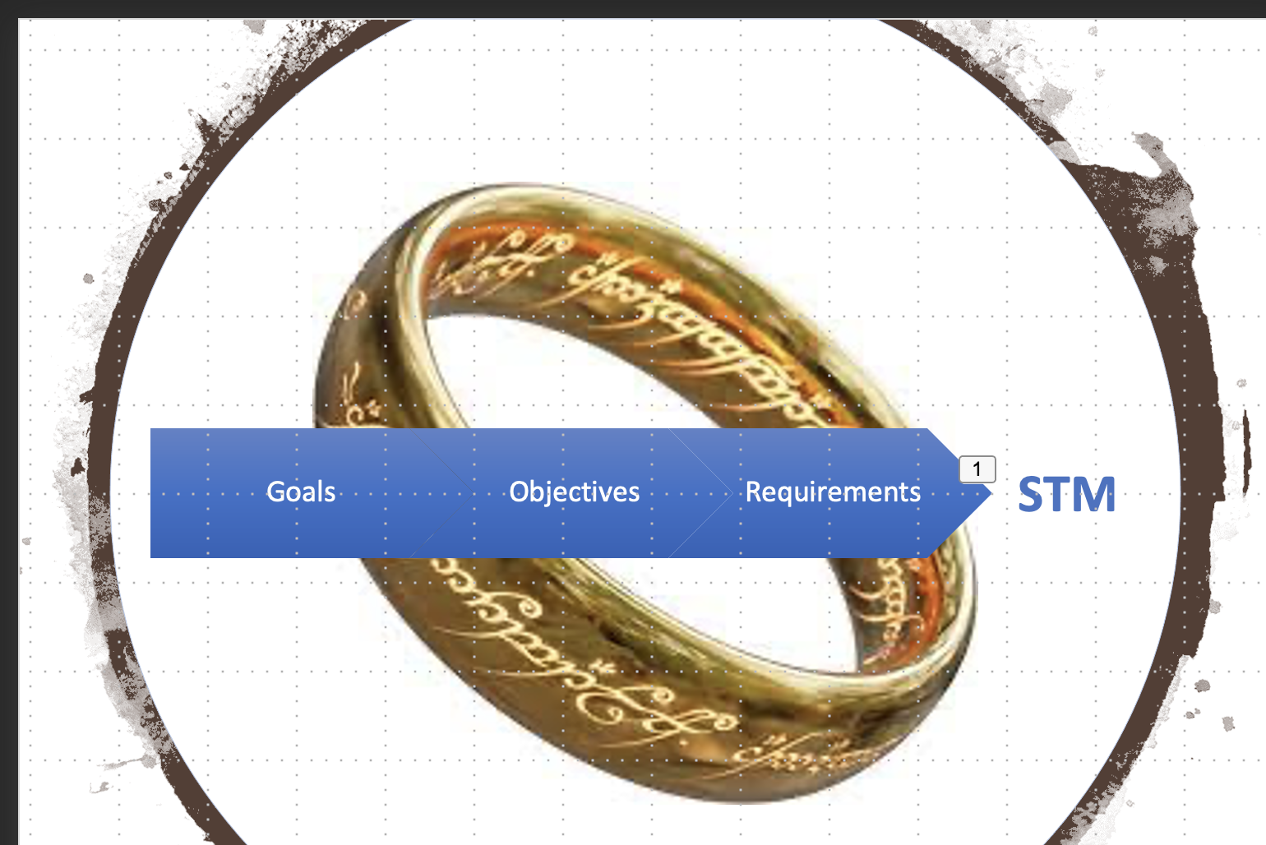

Level 1, Level 2…..
Mission Objectives
Level 0
Science Requirements
Mission Success Criteria
L1: Requirements for successful completion of the mission’s objectives.
Mission Success Criteria: L1s that must be met for NASA to declare the mission a success.
Level 1
System-Level
Engineering Requirements
L2: Flow from L1 and guide instrument function and performance details
Level 2
Subsystem Level
Engineering Requirements
Instrument-specific
Flow from L1
Science phase duration
Level 3
Levels
4 & 5
Component-level/
Sub-subsystem
Engineering Requirements

Slide 18
Notional System Hierarchy for Requirements
Level 1 – Mission
Mission
Level 2 – Segment
Observatory
Ground System
Launch Vehicle
Level 3 – Element
(System)
Support System
Bus/ Platform
Instruments/
payload
Thermal
Propulsion
Attitude Control
Mechanical
Level 4 – Subsystem
Communication
Data Handling
Electrical
Software
Level 5 – Component
Antenna
Xband

Slide 19
The Science “Shalls” Through the Life Cycle
PDR
CDR
Launch
End of Mission
End of
Extended
Mission
Phase A
(Concept)
Phase-B
(Product Definition)
Phase-C
(Design & Develop)
Phase-D
(Assembly & I/T)
Phase-E
(Operations)
Extended Mission Operations
Science Operations
Science “Shalls”
Evaluation of Level 1s
& Mission Success Criteria
Development of additional Level 1s
Evaluation
of Extended
Mission L1s
Requirements
Documents
Requirements frozen around PDR
Flight Unit
Assembly/Testing
Science & Instrument
Operations Plans
Instrument
Delivery
Level 1s
Signed
Requirements derived
through design iterations
Time
Notes:
CDR: Critical Design Review
ICDs: Interface Control Documents
PDR: Preliminary Design Review
“The goal of requirements development is to deduce, capture, and agree upon a set of functional requirements and product characteristics that will achieve the stated business objectives. Requirements management, then, involves everything that happens with the requirements in the product lifecycle once the requirements are developed. The demarcation between requirements development and requirements management is the defining of a requirements baseline. A baseline is a snapshot in time that represents the agreed-upon set of requirements for a specific product release.”
--from Wiegers, K. “Requirements Management: The Proven Way to Accelerate Development”

Slide 20


DESCOPES: Baseline vs. Threshold?
Based on the budget and schedule, what can you live without and still achieve your mission?
Baseline science requirements are the mission performance requirements necessary to achieve the full science objectives of the mission.
I want it all,
I want it all,
I want it all…
Threshold science requirements are those mission performance requirements necessary to achieve the minimum science acceptable for the investment.
You can’t always get what you want, but if you try sometimes, you just might find, you get what you need…
Photo - https://www.loc.gov/exhibits/british/brit-7.html

Slide 21
Critical Requirement
A requirement where the consequence of not meeting the requirement has significant impact or high sensitivity on the mission’s ability to meet negotiated success criteria, as assessed by the requirement owner.
What will impact the
ability to meet the level 1 requirement?
Driving Requirement
A requirement where compliance is deemed particularly difficult or the likelihood of needing additional resources to meet the requirement is significant, as assessed by the requirement implementer.
Meeting this requirement may introduce additional challenges.

Slide 22





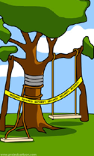
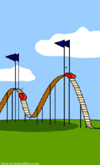

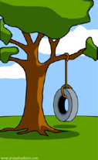
What the scientists wanted
What the PM envisioned
How the engineer saw it
How the requirements were documented
After PDR...
After CDR...
What the project was going to cost
What the project could afford
What the scientists really needed

Slide 23
STM
Level 1
Program Level
Science Requirement
Level 2
Project Level
Science Investigation
Level 3
Project Level
Instrument System
Level 3
Project Level
Mission System
Notes:
. Remember that science traceability matrix? We’ll take it one step further. Now—since you’re not working alone and since engineers will need to know how this all fits together, we’ll talk about requirements. To get to these, you need to know where you’re going, so risk, formulation and architecture are key.

Slide 24

Why should they become my friends?
The power to define your own path and prove it. You’re not surprised by what you get (“deliverables”) or what your deliverables will do (and your stakeholders aren’t either).
Mission Flexibility When your requirements are written with baselines/thresholds and in a flowed down manner, you’ll have the ability to adapt when situations change (and they will!)
Verification and Validation Did you do (in a unique and quantitative way) what you said you were setting out to do?
Clear communication to your team, your stakeholders and the community.
We trust our baristas.
We should hope to build trust
with our stakeholders as well.

Slide 25
STM
Level 1
Program Level
Science Requirement
Level 2
Project Level
Science Investigation
Level 3
Project Level
Instrument System
Level 3
Project Level
Mission System
Notes:
. Remember that science traceability matrix? We’ll take it one step further. Now—since you’re not working alone and since engineers will need to know how this all fits together, we’ll talk about requirements. To get to these, you need to know where you’re going, so risk, formulation and architecture are key.

Slide 26

Betsy Pugel
NASA Goddard Space Flight Center
Betsy.Pugel@nasa.gov
Office: (301) 286-6607
Mobile: (202)302-8269

